Slide 1
Edge detection with different pixel stride
Deividas Šetkus ifm8-1
Aurelija skučaitė ifm8-1

Slide 2
task
To implement differential gradient edge detection algorithm with 2-pixel stride and a downsampled version with 1-pixel stride. Afterwords compare:
Accuracy
Performance

Slide 3
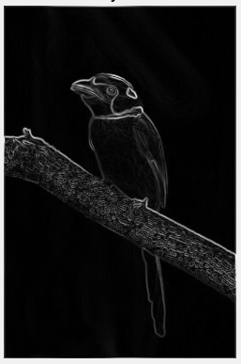
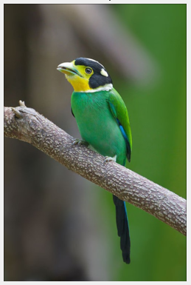
EDGE DETECTION
Edge detectors are a collection of very important local image preprocessing methods used to locate (sharp) changes in the intensity function.

Slide 4
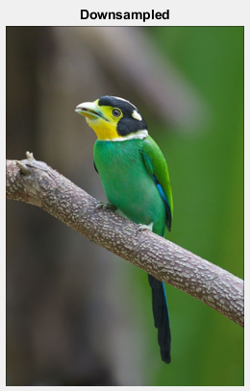
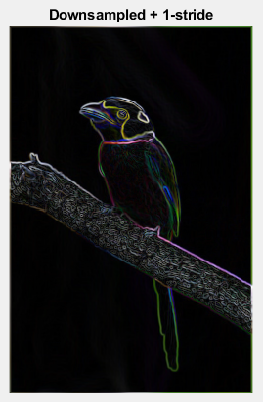
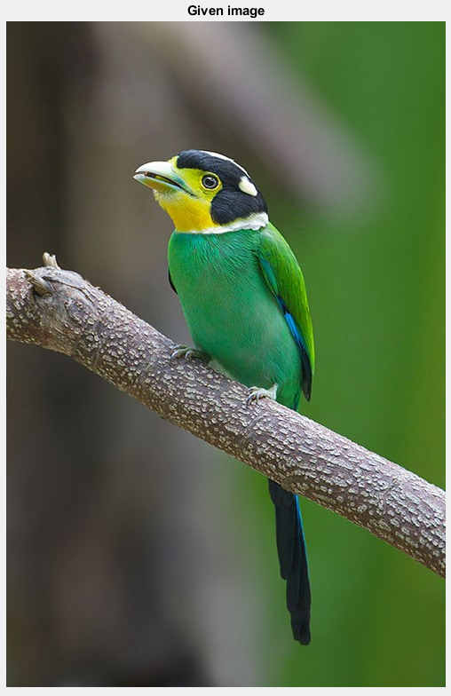
PROCESS 1
Image -> Gaussian blur(optional) -> Downsampling -> Sobel operator with 1-pixel stride

Slide 5
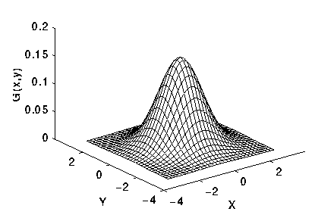
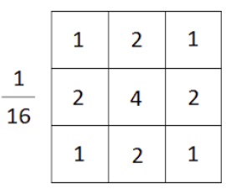
Gaussian blur
Gaussian smoothing operator is a 2D convolution operator, used to blur images and remove detail and noise. The kernel represents the shape of a Gaussian (bell shaped) hump.

Slide 6
PROCESS 1
Image -> Gaussian blur(optional) -> Downsampling -> Sobel operator with 1-pixel stride

Slide 7
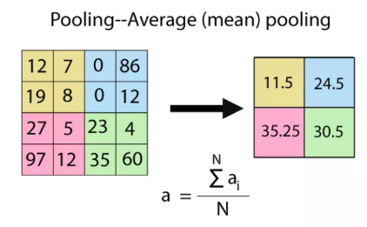
downsampling
Pooling is the idea of reducing the number of a group of values by choosing only some of the values or calculating new values to represent the previous ones.

Slide 8
PROCESS 1
Image -> Gaussian blur(optional) -> Downsampling -> Sobel operator with 1-pixel stride

Slide 9
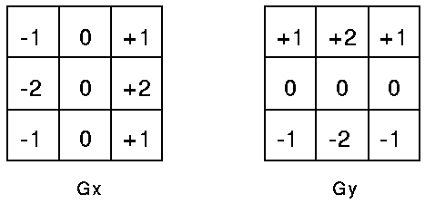
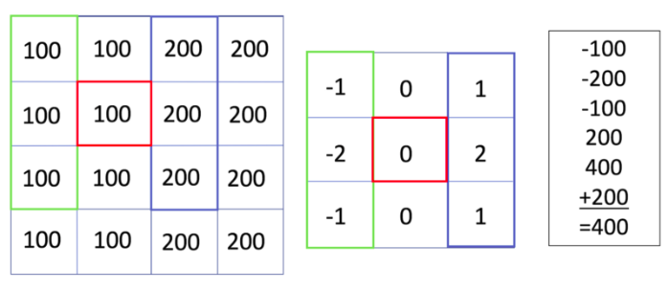

Sobel operator
Its a differential gradient operator, estimating local intensity gradients with the aid of two convolution masks (Gx & Gy):
Local edge magnitude is computed vectorically using nonlinear transformation

Slide 10
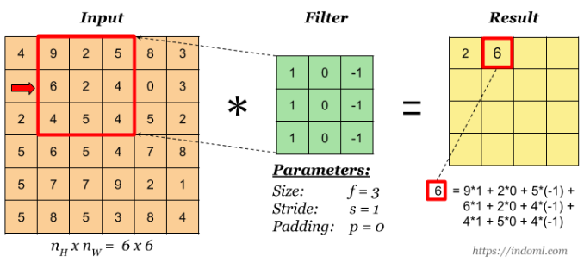
Sobel 1-pixel stride

Slide 11
PROCESS 1
Image -> Gaussian blur(optional) -> Downsampling -> Sobel operator with 1-pixel stride

Slide 12
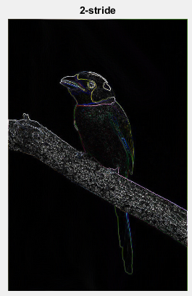
Process 2
Image->Gaussian blur(optional)->Sobel operator with 2 pixel stride

Slide 13
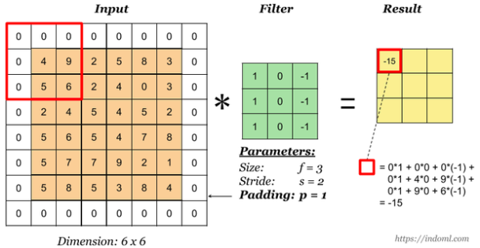
Sobel 2-pixel stride

Slide 14
Process 2
Image->Gaussian blur(optional)->Sobel operator with 2 pixel stride

Slide 15
comparison

